Slide 1
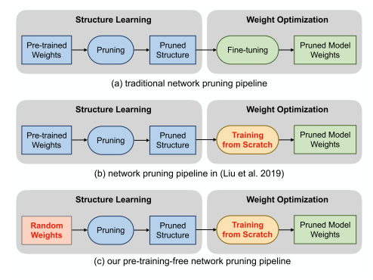
1. Pruning from Scratch
INFO
Main idea
2020 AAAI
1Tsinghua
2Ant Financial
3Huawei Noah’s Ark Lab
fine-tuning-free
pre-training-free

Slide 2
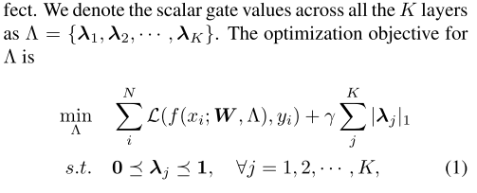
1. Pruning from Scratch
Network Slimming方法：直接对channel进行裁剪
W：随机初始化权重 Λ：各layer各channel的gate value
在随机初始化的条件下通过训练学习每个channel的重要性

Slide 3
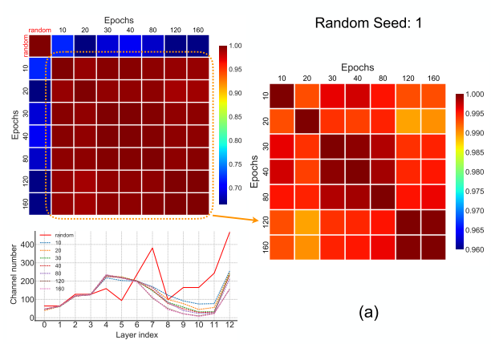
1. Pruning from Scratch
Contributions：
pre-training-free：speed up the time to get pruned model
Pruned from initial random weight, this pipeline can explore a larger structure space.
Notes:
structure is important!

Slide 4
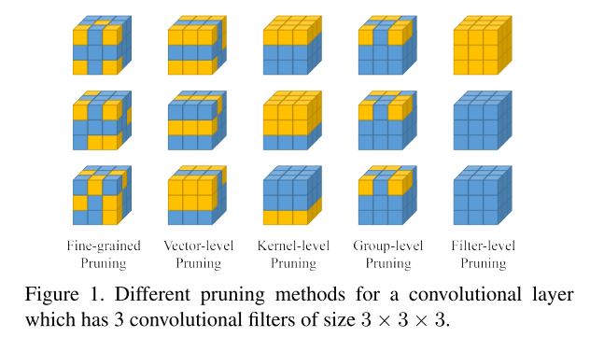
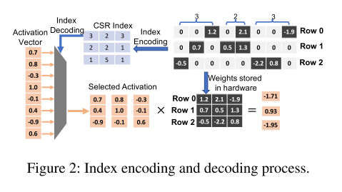
2. DARB: A Density-Adaptive Regular-Block Pruning for Deep Neural Networks
INFO
2020 AAAI 1Alibaba DAMO Academy 2 Northeastern University
Irregular Pruning:
decoding one index requires a search over the whole activation vector, and thus it brings little acceleration and even speed degradation.

Slide 5
2. DARB: A Density-Adaptive Regular-Block Pruning for Deep Neural Networks
INFO
2020 AAAI 1Alibaba DAMO Academy 2 Northeastern University
Structure Pruning:
enforce all rows in the weight matrix to have the same number of weights retained
group neighboring weights into certain structures
Guess:
The methods break up the row density variety
Not all the rows is of equal importance
Locally salient weights in group have similar salience to globally salient weights

Slide 6
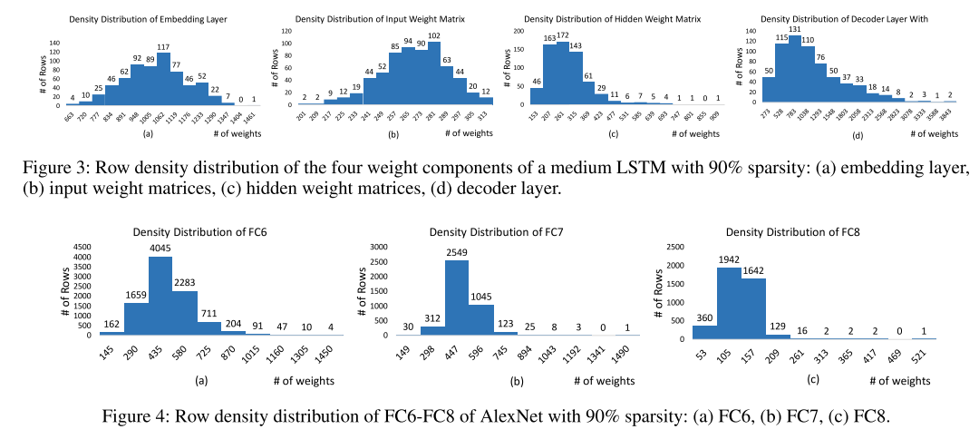
2. DARB: A Density-Adaptive Regular-Block Pruning for Deep Neural Networks
The row density distributions vary significantly not only across different neural networks, but also across different layers within the same network, and even across different rows within the same layer.

Slide 7
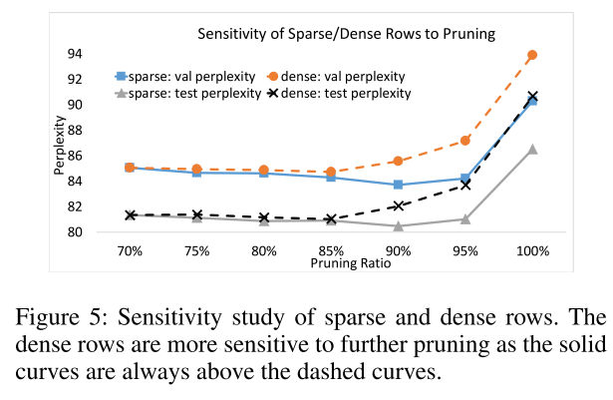
2. DARB: A Density-Adaptive Regular-Block Pruning for Deep Neural Networks
2. The dense rows are more sensitive than the sparse rows to further pruning.

Slide 8
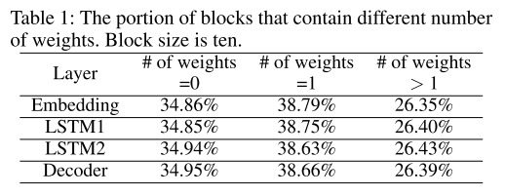
2. DARB: A Density-Adaptive Regular-Block Pruning for Deep Neural Networks
3. when dividing all rows into equally sized blocks and selecting in each block one weight with the largest magnitude, these locally salient weights have simi- lar salience to the weights globally selected over the whole weight matrix

Slide 9
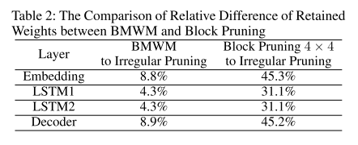
2. DARB: A Density-Adaptive Regular-Block Pruning for Deep Neural Networks
3. when dividing all rows into equally sized blocks and selecting in each block one weight with the largest magnitude, these locally salient weights have similar salience to the weights globally selected over the whole weight matrix
BMWM
block-max weight masking

Slide 10
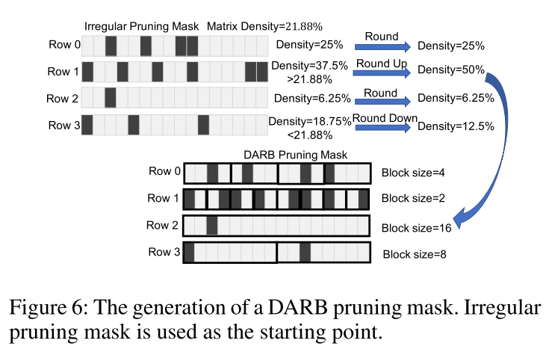
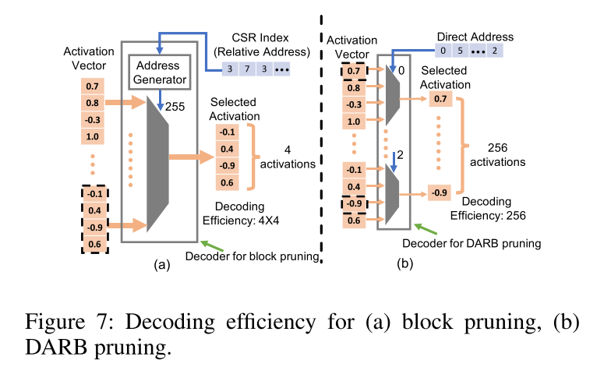
2. DARB: A Density-Adaptive Regular-Block Pruning for Deep Neural Networks
DARB

Slide 11
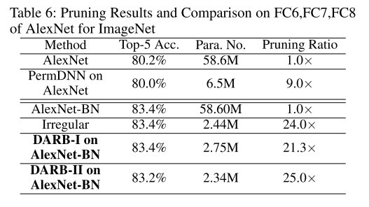
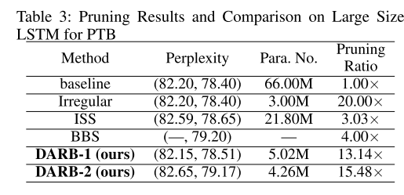
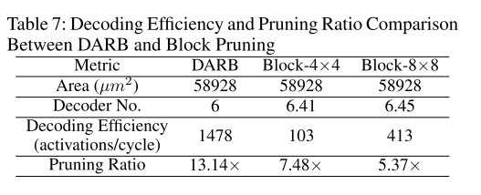
2. DARB: A Density-Adaptive Regular-Block Pruning for Deep Neural Networks
Results

Slide 12
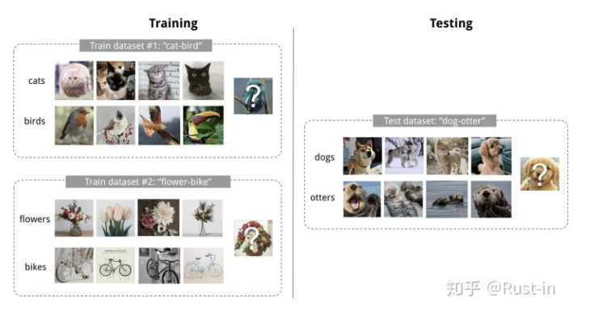
3.Real-Time Object Tracking via Meta-Learning: Efficient Model Adaptation and One-Shot Channel Pruning
INFO
2020 AAAI Korea
Meta-learning
通过在初始参数的基础上进行一或多步的梯度调整，来达到仅用少量数据就能快速适应新task的目的

Slide 13
3.Real-Time Object Tracking via Meta-Learning: Efficient Model Adaptation and One-Shot Channel Pruning
Contributions：

